Slide 1
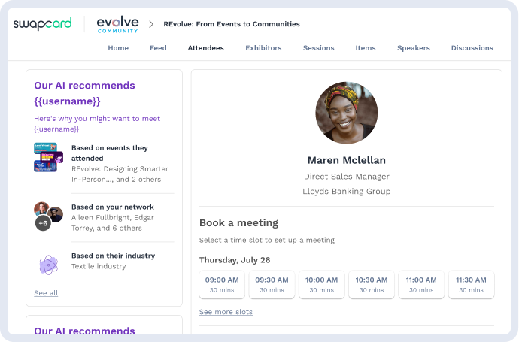
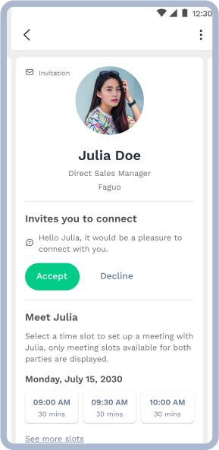
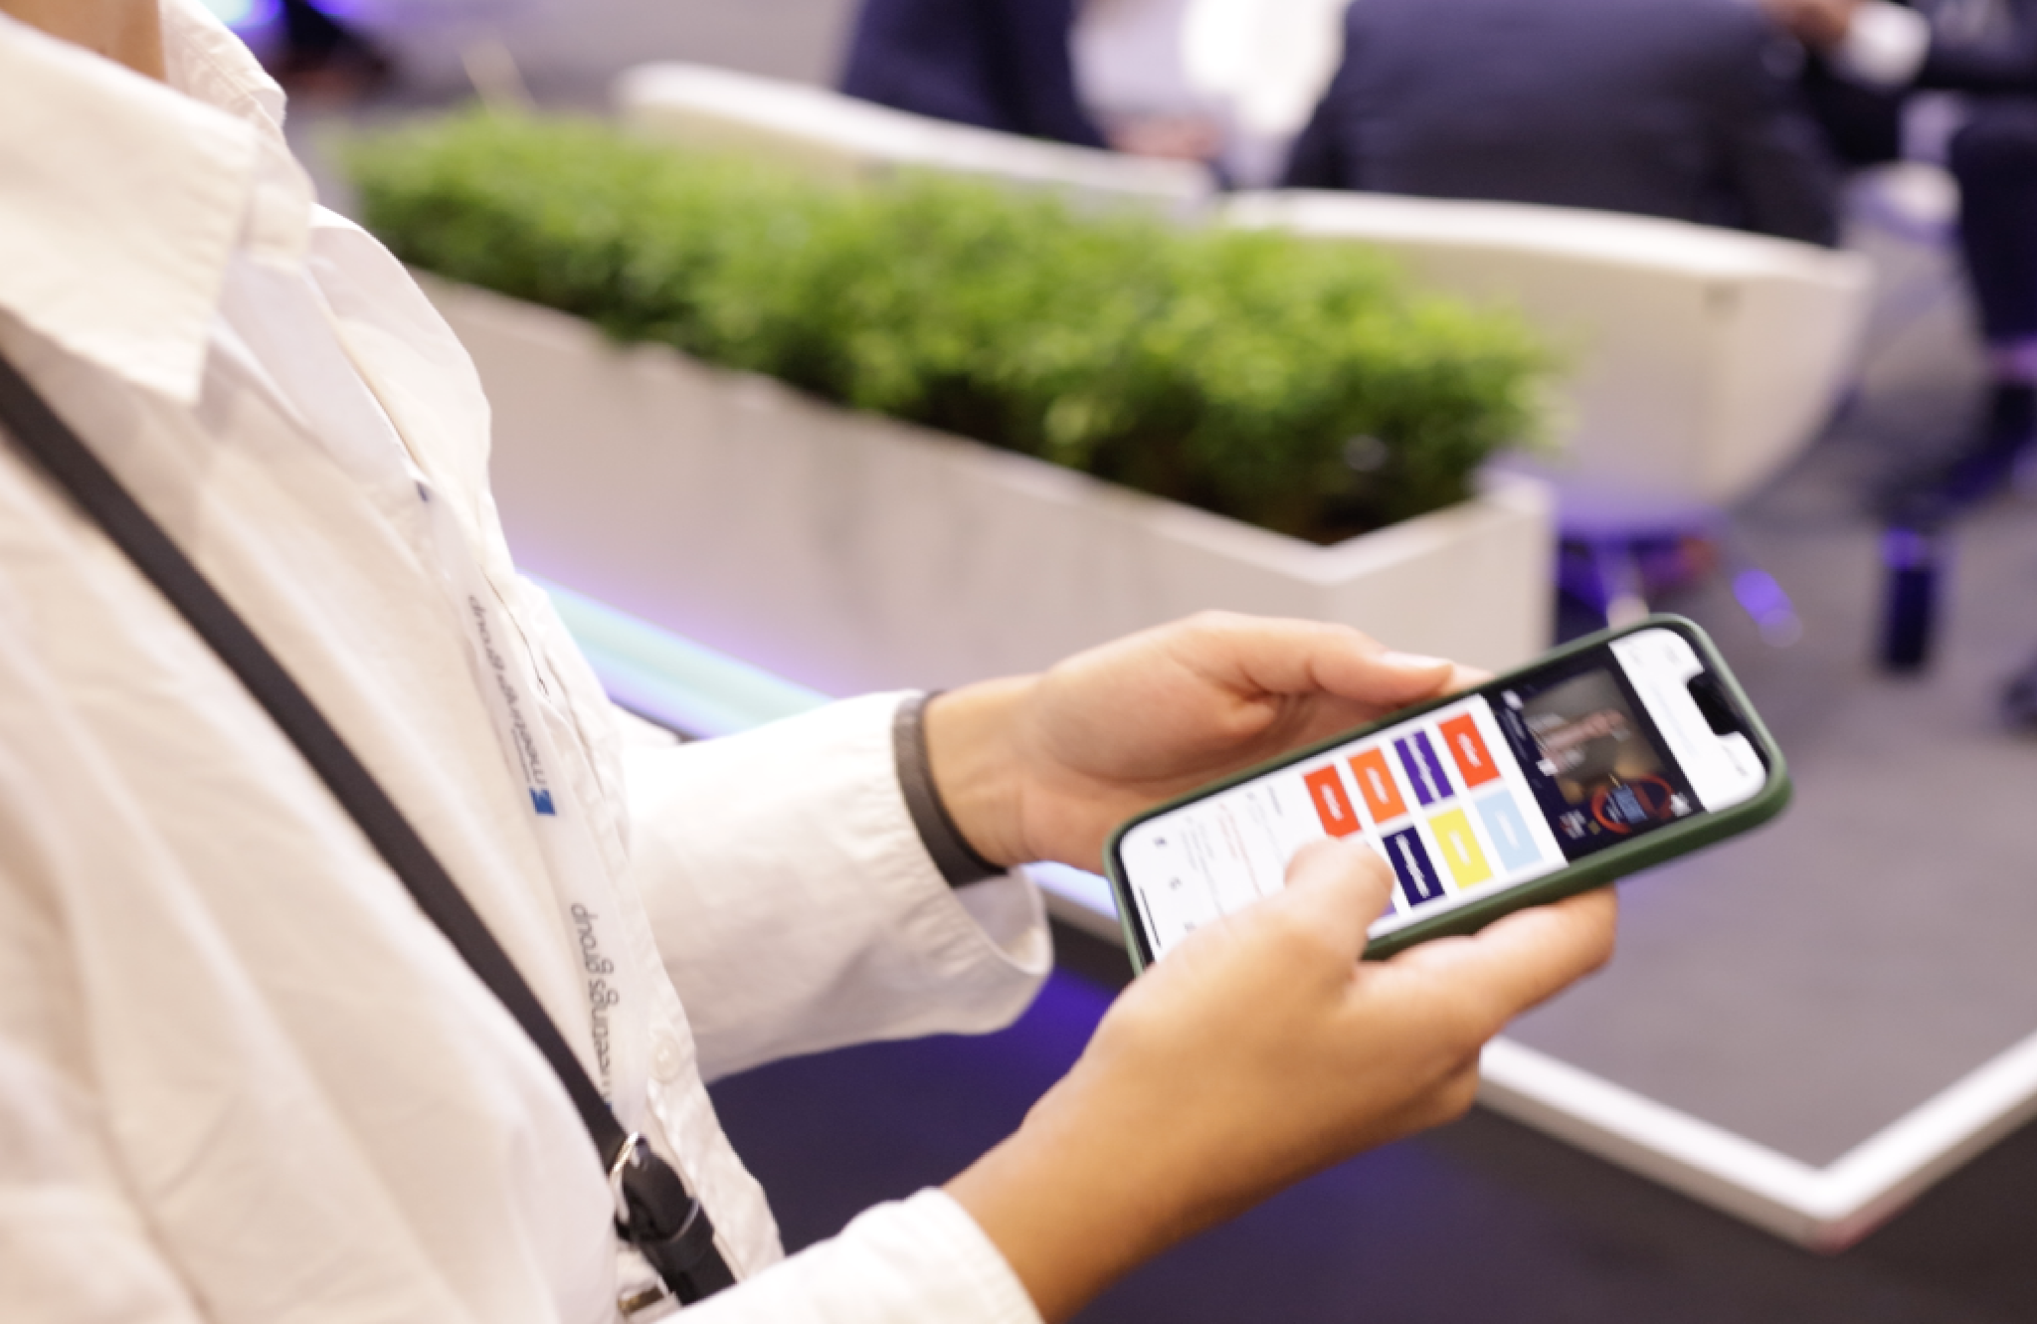
User’s Guide
General guide

Slide 2
Access the app
Login

Slide 3
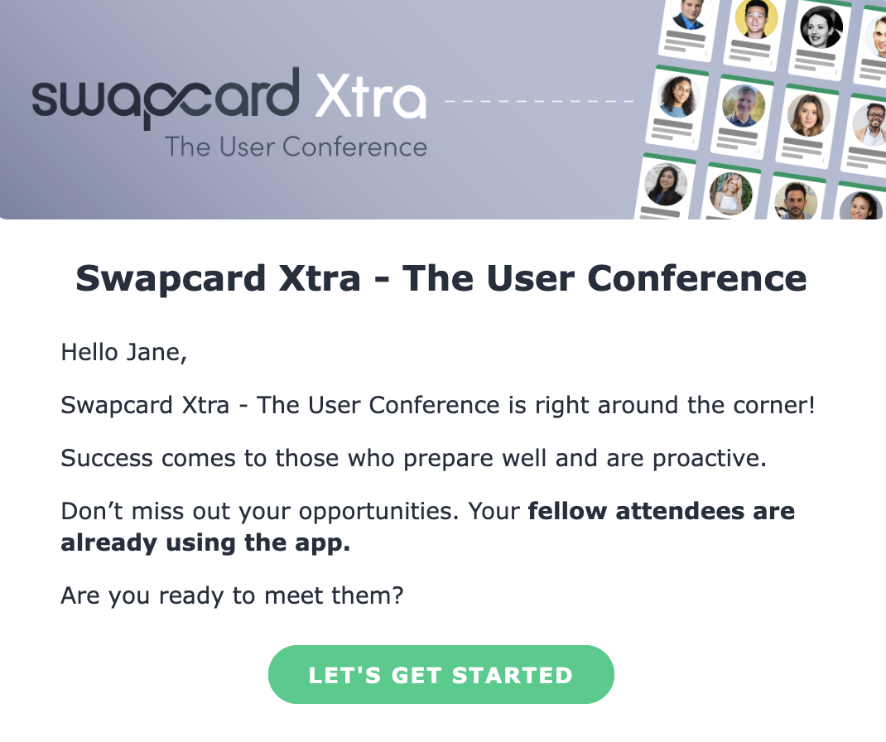
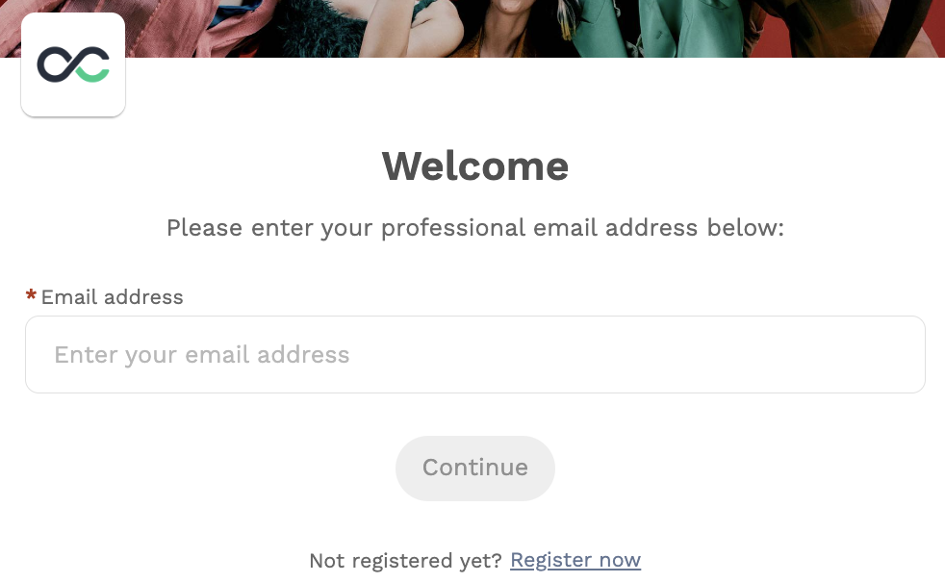

How to login for the first time?
You will receive an email similar to this ones with a button redirecting you to a login page. Your account is automatically created by the platform after you have registered. A window will then prompt you to create a password for your account:
1
You can also access the event from your phone by downloading the Swapcard app (iOS/Androïd) or the event branded app.
2
Note: If you don’t see this email in your mailbox, please check your spam folder. Most of our emails are sent from noreply@swapcard.com

Slide 4
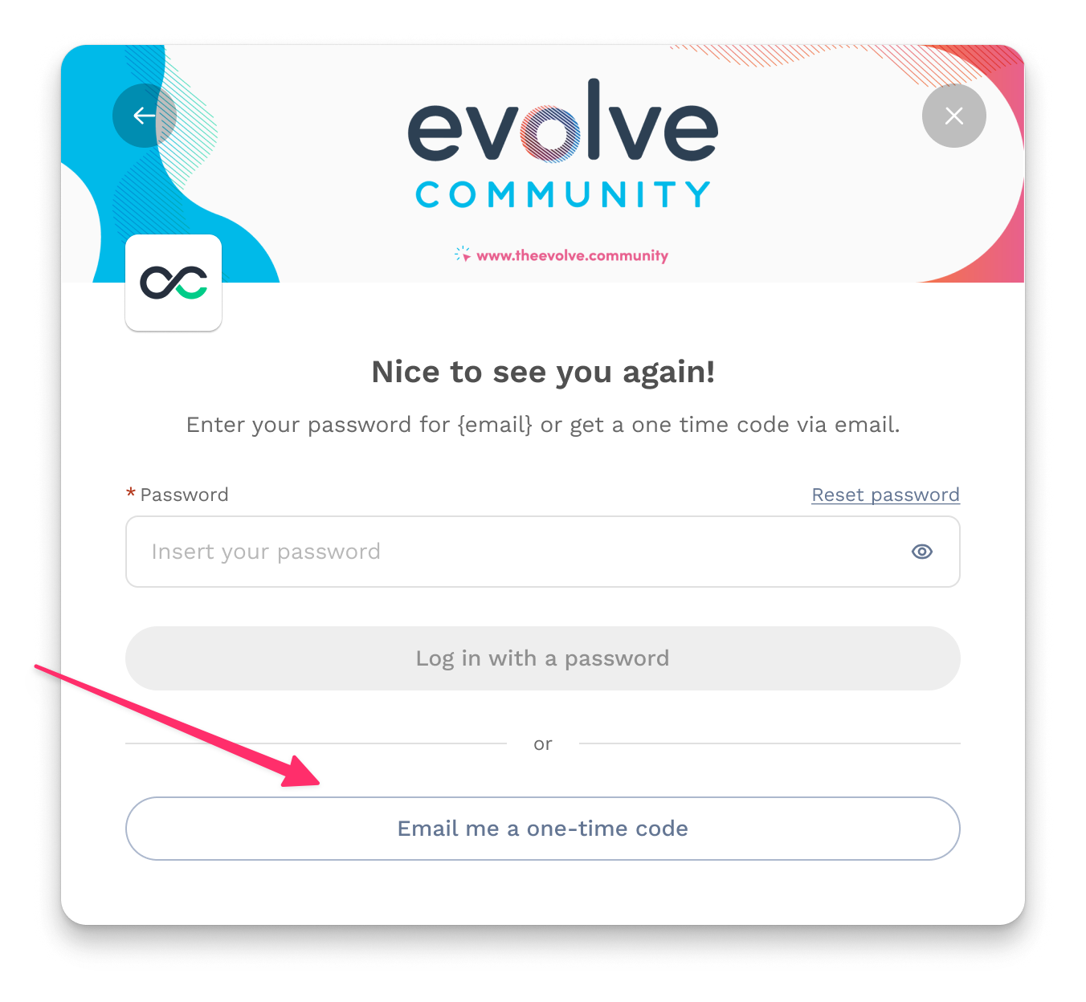
How to login when I have an account?
1
Access your account on app.swapcard.com
2
Enter the email you used to register for your event
3
You will then be prompted to enter your password (if previously set) or notified that a one-time code has been sent to your email. If unsure of your password, you can request a one-time code. You'll promptly receive an email with a code that you can enter into the designated box.
If you need any help, please contact our Support Team.
4

Slide 5
Physical Event
QR code / Scan badge

Slide 6
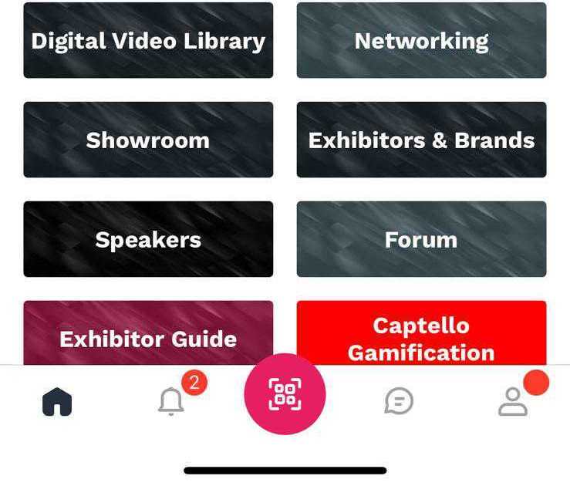
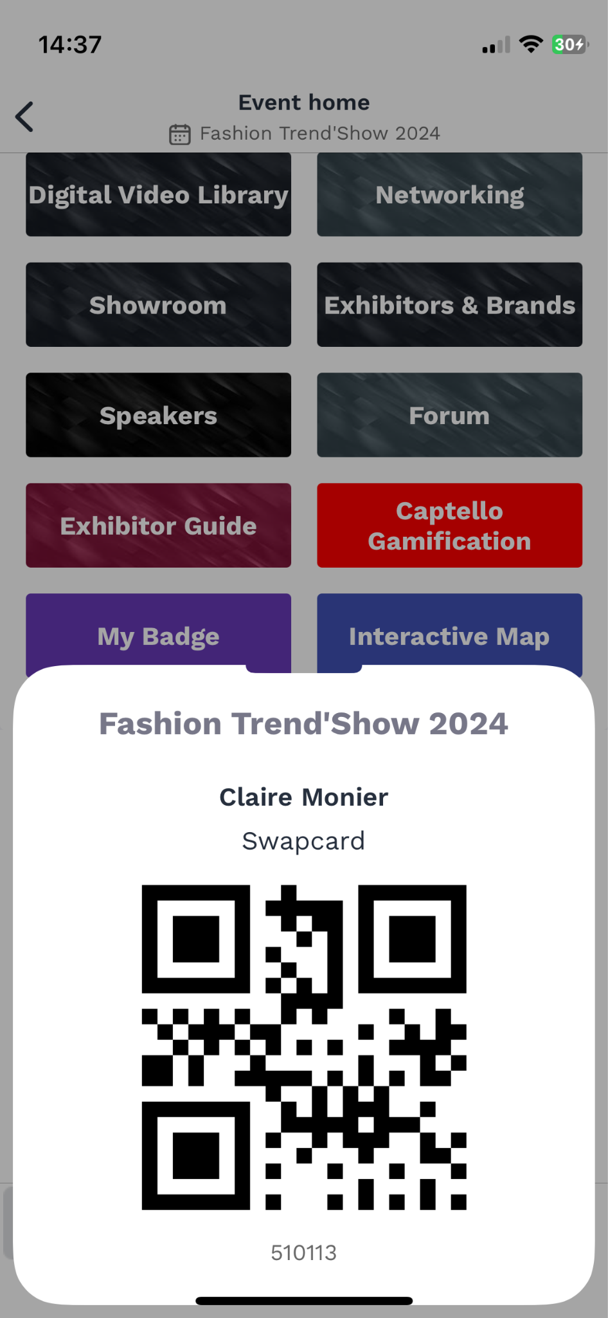
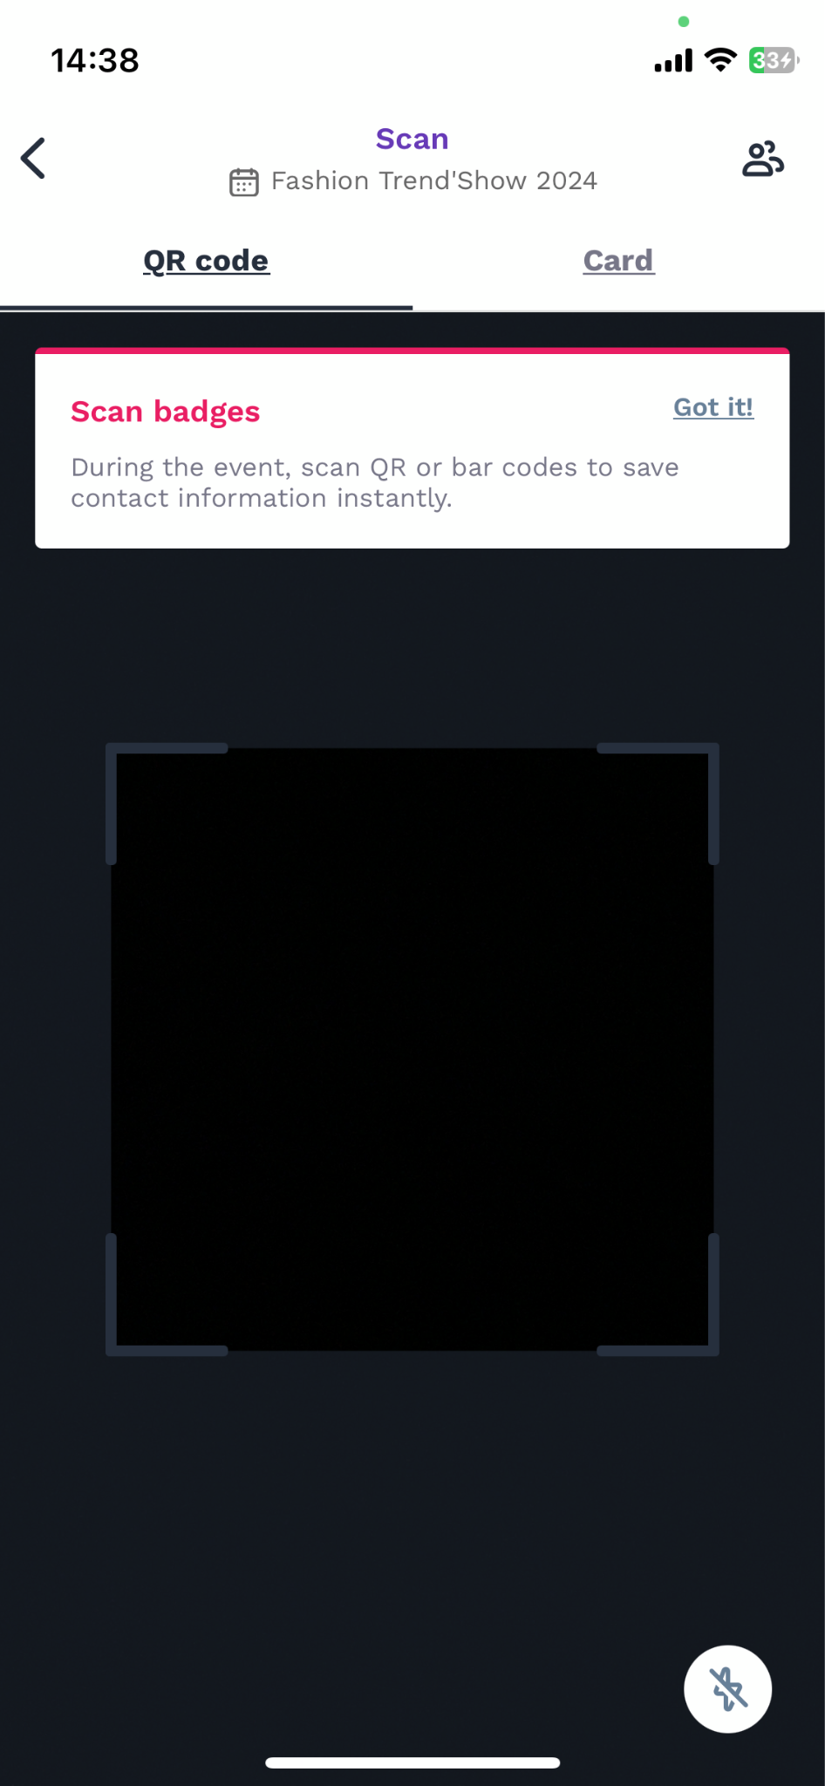
App/ Badge Scanning
To scan a badge, click the scan icon on the
home screen of your event.
By scanning the QR code of an attendee’s badge, you automatically add it to your contacts. This allows you to chat, share contact details and add tags and scoring to your contact. If the 2-way scan is enabled - Your contact details are also shared to the person you scanned (please check if the feature is enabled with the event organizers).
You can display your electronic badge to be scanned. A dedicated button will be available on the homepage to display your QR code.
I’m scanned
I’m scanning

Slide 7
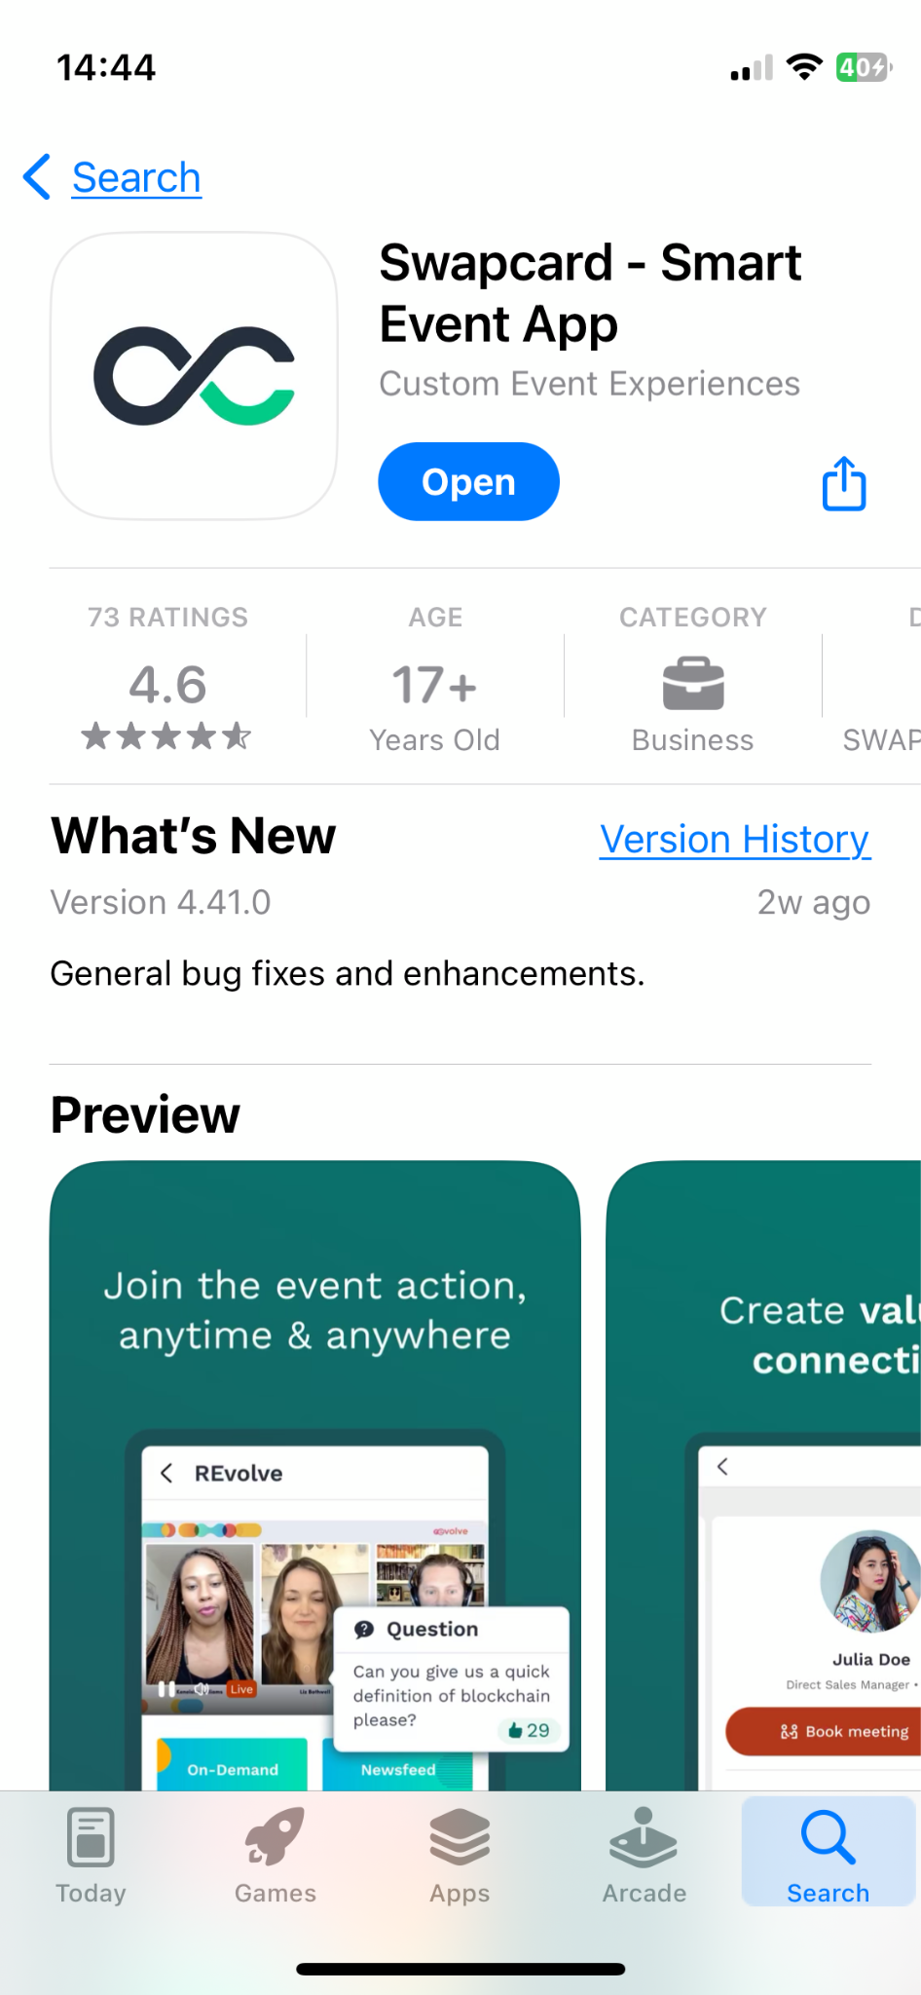
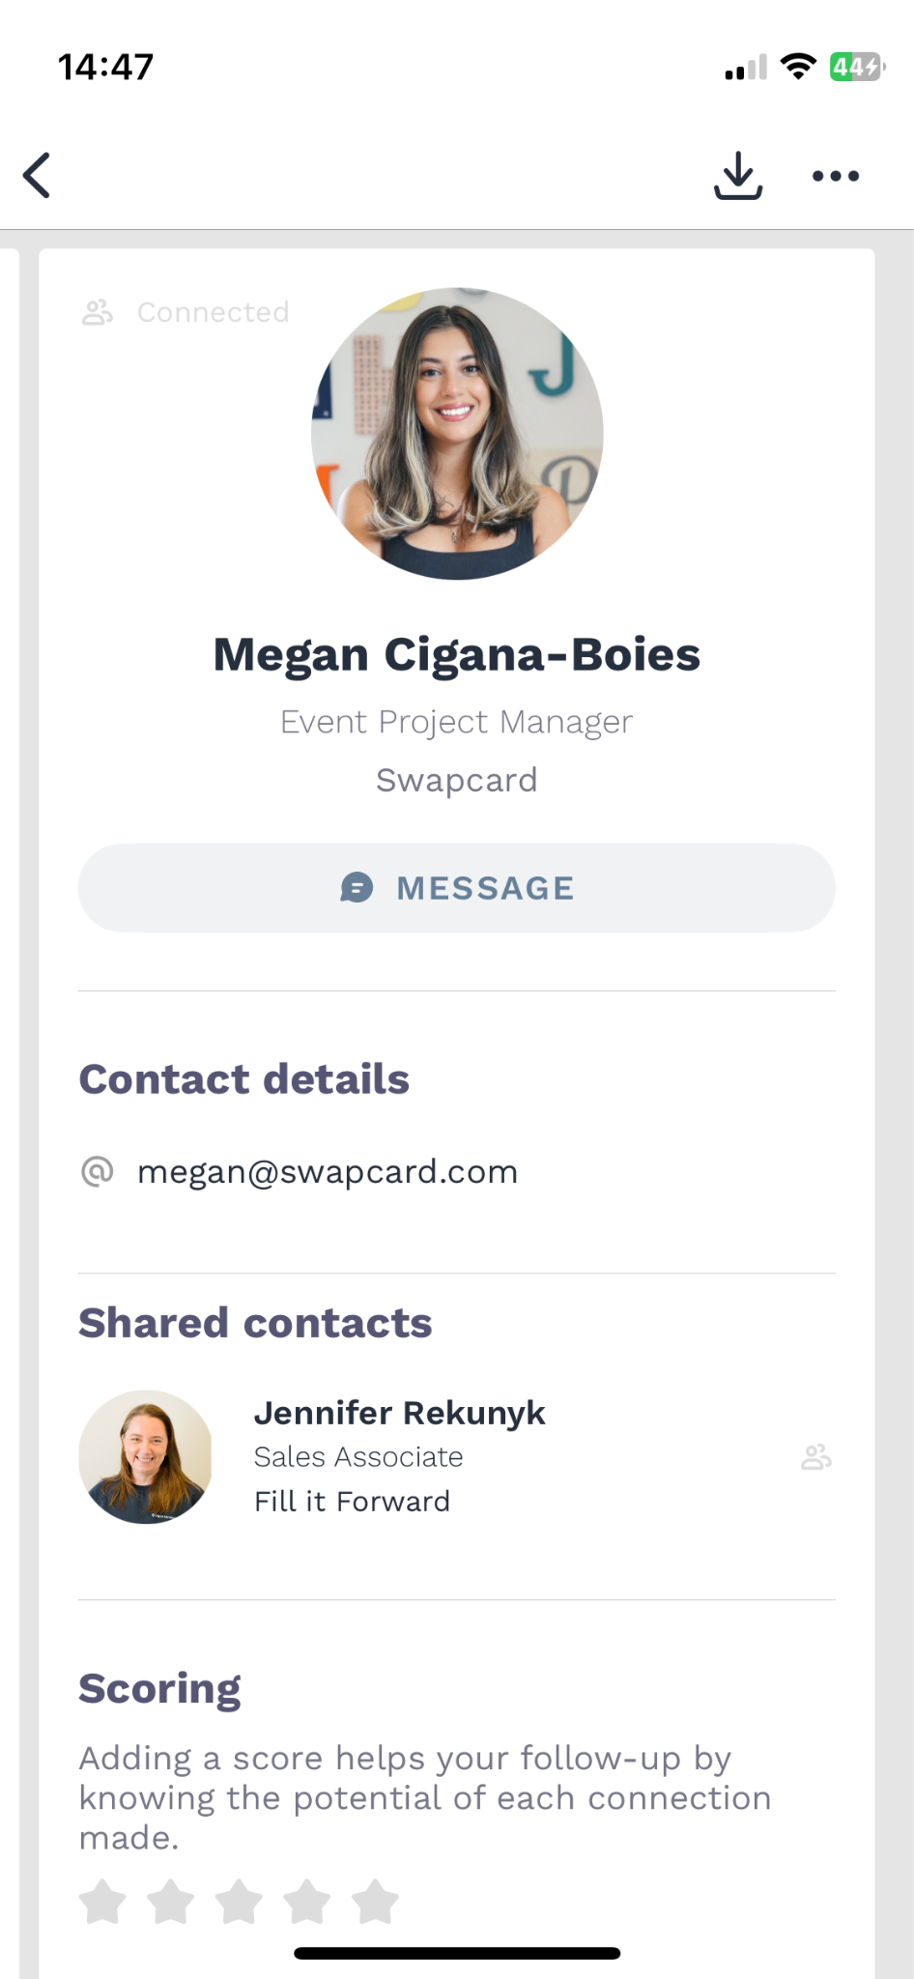
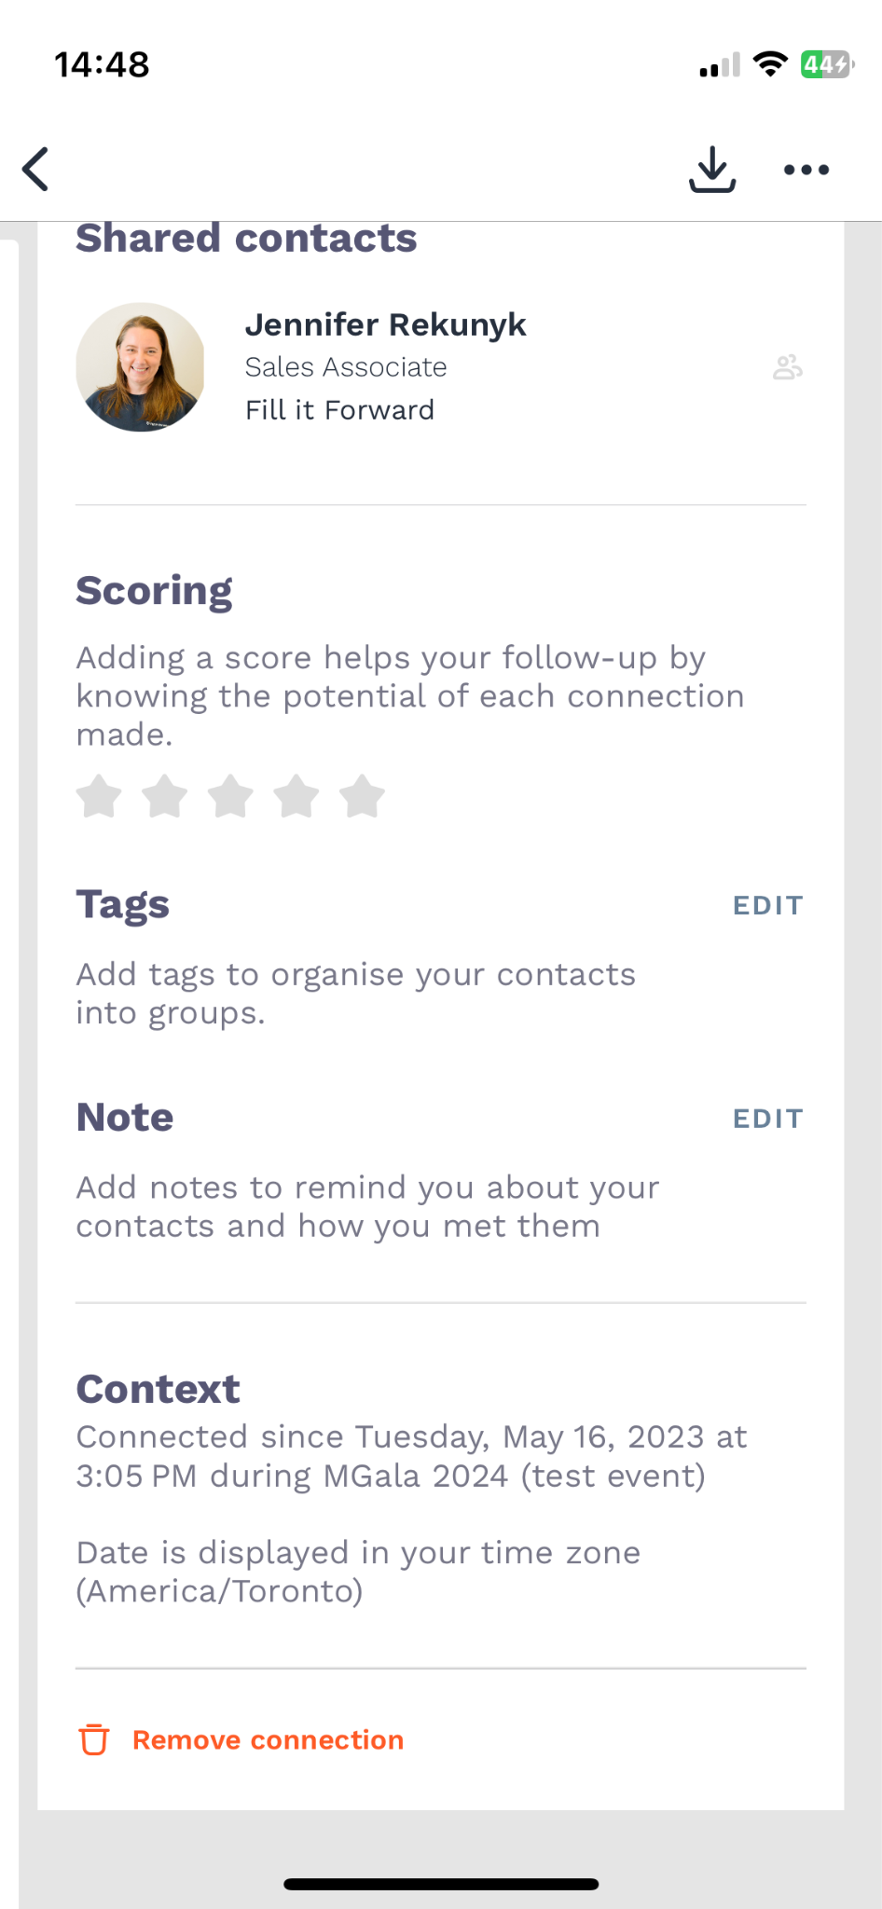
How to Scan a Badge
1
2
3
Download the Swapcard or Event app
Open the camera and scan the QR code
You will have access to the participant's information (From the “My Contacts” tab)
Notes:
** Underlined experiences are done through the swapcard platform
Talking points + Story:
Mail in/Virtual Registration for event occurs (7) days before start of onsite event – Event goes Live on Swapcard Platform:
Receives welcome package event materials with QR code to download the app and access their digital badge (No Physical badge required, as your virtual badge exists within the mobile app)
Curiosity will drive attendees to engage with platform – key interactions will be with headlining sponsors with large brand presence.
Both DO & IP attendees can begin to engage on the Swapcard app or web-browser based platform.
IP can begin to identify other IP or BL targets they would like to meet onsite.
At first log in DO audience have unique expereince or welcome to differentiate – Drive sharing of personalized experience via social.
How to get the most ROI from your event (6) days before start onsite event:
Personalized for IP and DO audiences
Drive that Swapcard is the bridge across IP/BL/DO audiences, and will be the only way to optimize ROI across all personas.
Similar to the ‘Road To Dreamforce’ : https://www.pcma.org/salesforce-weekly-tv-series-dreamforce-conference-attendees/
Nothing new for exhibitors/sponsors – This messaging has already been delivered to your key partners as part of a previous series to help assure success/onboarding. This session can be used as a final call to action for all key partners.
Just like in a traditional event, Sponsor/Exhibitor meeting setting will be key, but unlike before where this was segmented, it would all occur through the platform, allowing those companies better trackable data YoY and visibility to full funnel touch points.
Micro Community networking event (4) days before start of onsite event
DO:
Based off registration DO individuals placed into pods based off of unique interests/icebreakers/key goals
Pods begin to share their interests of events, new innovations with the market, sponsors, or potentially group chats
IP:
Introduction to pods made on platform with virtual pre-meeting introductions. Onsite- there will be a pod meeting breaks throughout the event to help drive networking not only amongst the pod, but additional ‘similar minded’ IP/BL attendees met organically.
Both Audiences:
Allow for mixed groups of IP/BL and DO, to drive interaction among IP/BL/DO with common goals – promotion of minimally chat based engagements between personas during various sessions focused on common interests.
Story:
All engagements driven from pod-based networking will continue to optimize the AI portion of Swapcard. These behavioral tracking will allow better connections for both DO & IP attendees
Set the precedence that there is value amongst IP/BL/DO & engagement which can occur even during onsite event based on the attendee profiles through Mobile to Web based chat.
Chat function is the great equalizer across all personas throughout the event.
**Exhibitor & Sponsors focus their time and efforts leading up to the event engaging/meeting with DO audiences knowing their focus during on-site event will be IP. Main focus with IP audiences are meeting setting for onsite experience.
*GET HYPE KEYNOTE* (2) days before start of onsite event:
DO/IP/BL: Get Hype Keynote has two key functions. First, is to drive sign ups from potential attendees to the DO track after seeing how incredible the content will be. Second, is to get both audiences actively engaging with content/other attendees no matter their ‘level of access’. Be sure to highlight questions/value from DO & IP attendees during this keynote and set the tone for how best to engage with speakers/chat feature etc.
Goal Setting/Targeted Requests:
Heavy focus on educating the Attendee and Exhibitor/Sponsor on how to derive the most ROI from an event. Be sure to use past data from your virtual events, to show the potential value that exists amongst all audiences.
Example: An attendee pre-event who is not on your (the exhibitor) target list clicks on multiple of your products and bookmarks 2-3. Immediately the exhibitor could identify this and assure their team targets onsite.

Slide 8
Available Features
Content

Slide 9
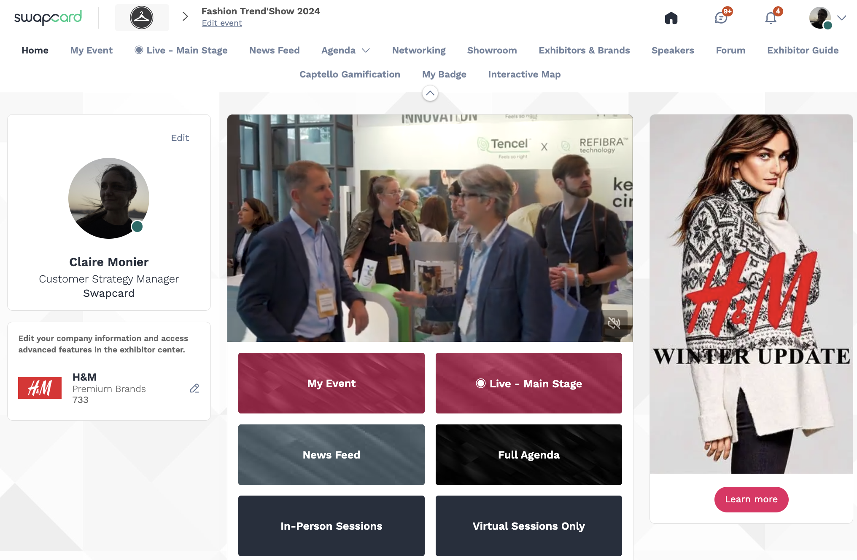
How to edit your profile (1/3)
1
2
There are two ways of accessing your profile:
From the drop-down on the upper-right corner of your screen, click “My profile”
On the left side of your screen
next to your photo, click “Edit”
You’ll be redirected to your profile where you can edit your information.

Slide 10
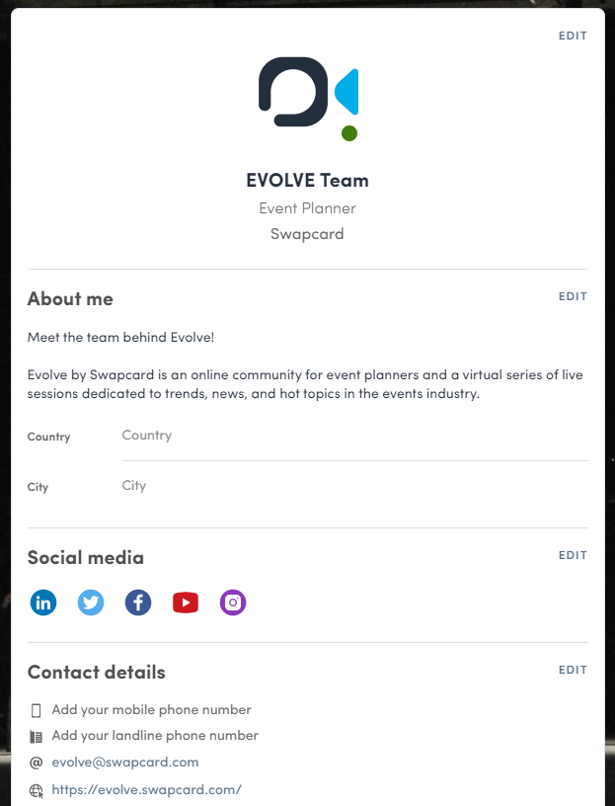
How to edit your profile (2/3)
To edit your profile, click “Edit” or “Add” next to
the information section you want to edit.
Here is the information you can edit:
Personal information
Biography
Social Media
Contact details
Company
Additional fields added by the organizer

Slide 11
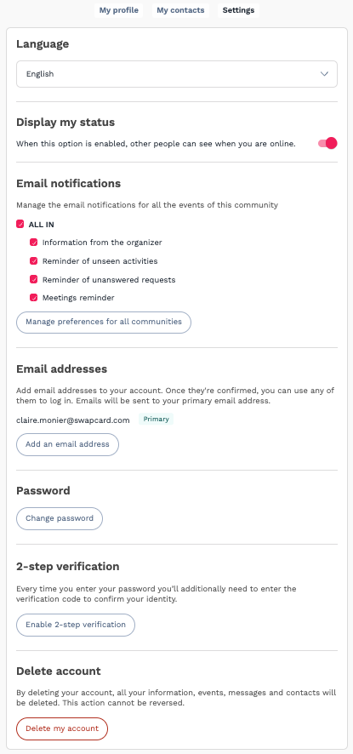
How to edit your profile (3/3)
From the “My Settings” tab, you can update your account preferences:
Language
Display my status
Email notifications
Email addresses (add secondary email) details
Update my password
2-steps verification
Delete my account

Slide 12
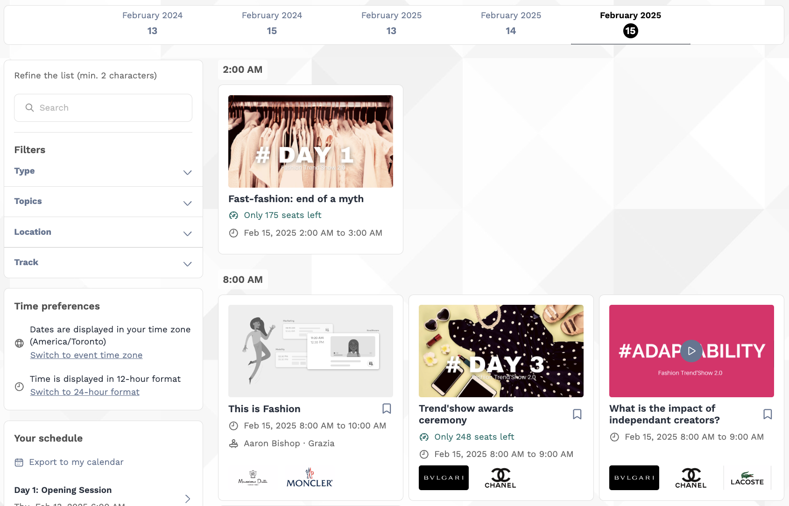
How the schedule works
The schedule/agenda button gives you an overview of the event sessions. You can register for sessions by clicking on this bookmarking icon.
You can find sessions by using the search bar and filters located on the left side of the screen.

Slide 13
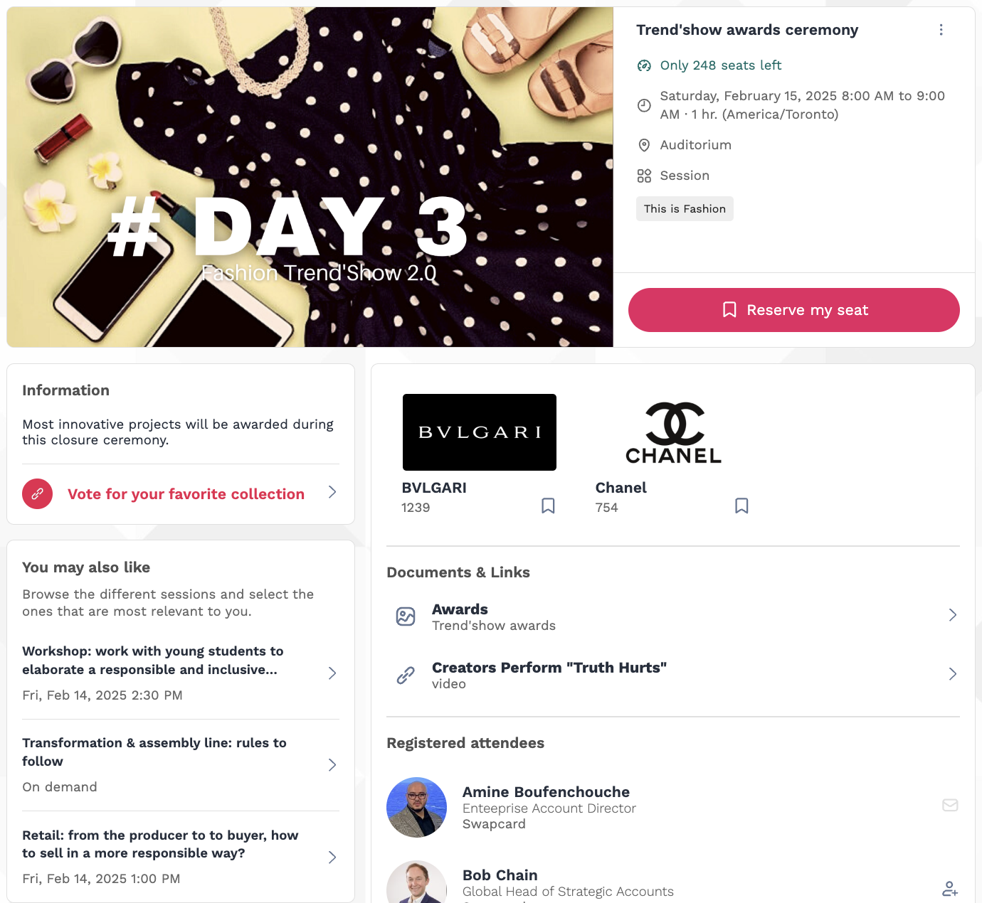
How the schedule works
By selecting a particular session, you'll uncover comprehensive details tailored to your interests: session capacity (if applicable), dates, times, and location; featured speakers and exhibitors; pertinent documents and links; and a roster of registered attendees (where applicable).

Slide 14
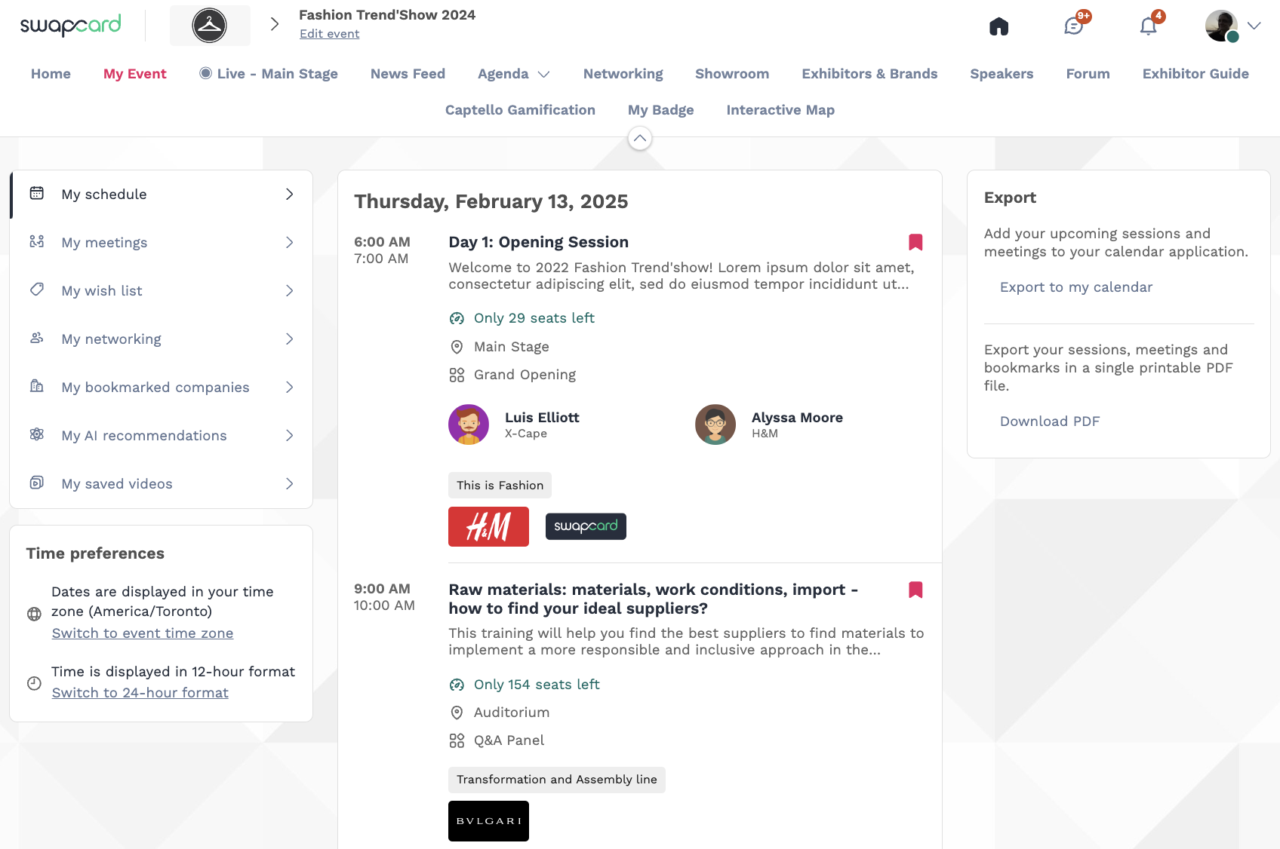
How the schedule works | My Event
The tab “My Event” allows you to see your own schedule. Here you can find the sessions, sponsors and partners you bookmarked, your confirmed meetings and more.
You can export your schedule by clicking “Export to my calendar” or “Download PDF.”

Slide 15
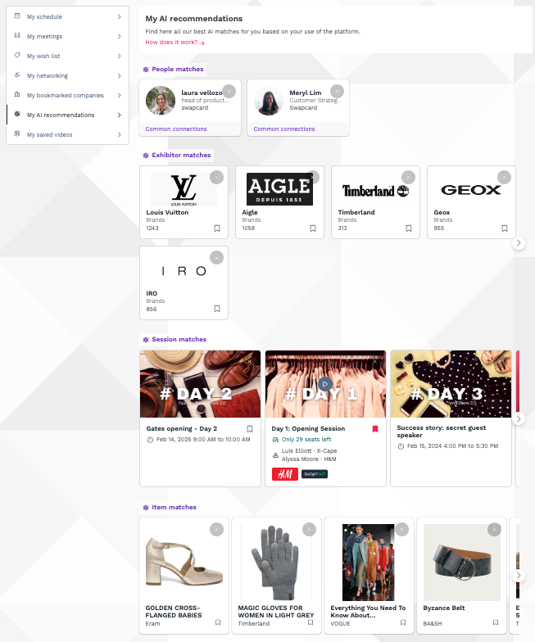
How the schedule works | My AI Recommendations
The "My AI Recommendations" tab, if enabled, curates a personalized list of People, Exhibitors, Sessions, and Items based on our advanced AI matching system.
The completeness of your profile significantly enhances the quality of recommendations, while your platform activity further refines the results.

Slide 16
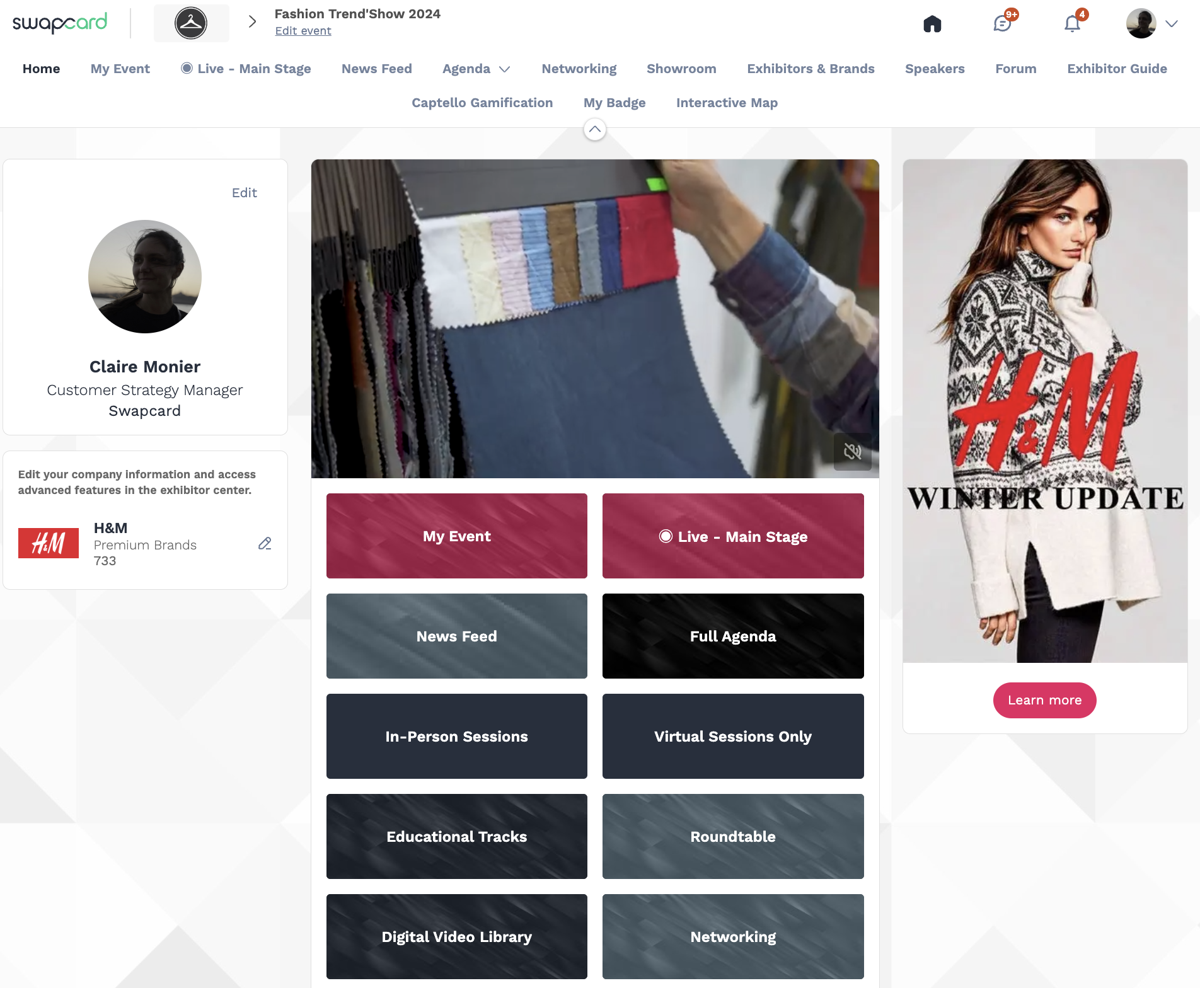
How to access an ongoing live session
There are several ways to access an ongoing live session.
From Event Home, click the “Live session” button. If there is a live session, the live button should also be present as a tab on the top navigation bar.
You will get redirected to the ongoing session, or the following one if nothing is happening at that time.
You can also access it from the “Event schedule” or “My Event” tab. Click on the ongoing session to reach the session page.
2
1
1
2
2

Slide 17
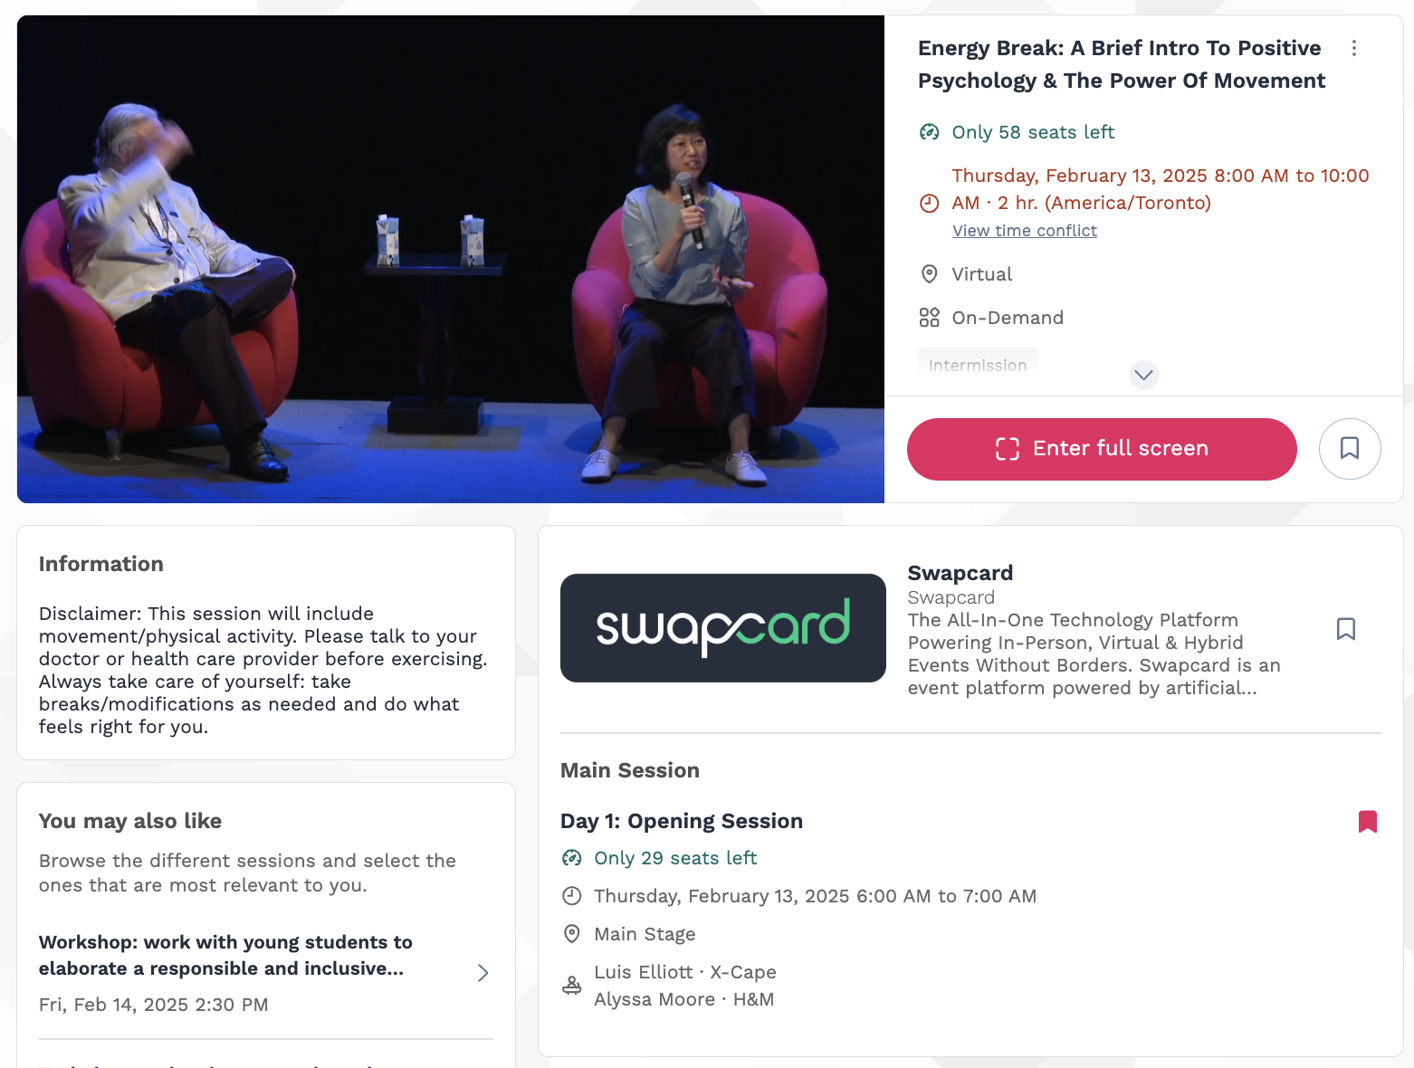
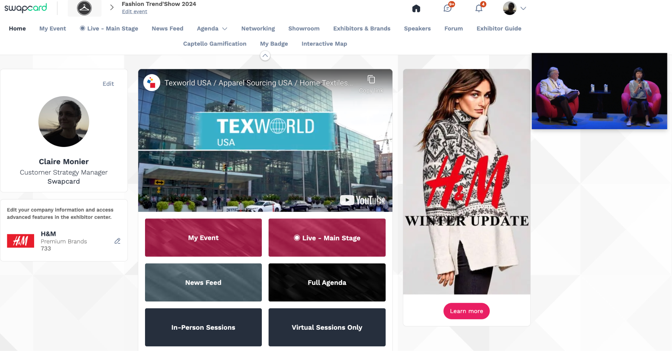

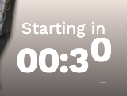
How to access a streaming session
Less than 24 hours before a live stream session a countdown will show on the session page.
As soon as the session begins, the video will be displayed at the top of the session page and will start automatically. You can refresh the page if it does not.
You will then be able to watch the video, in full screen mode if you wish, or continue to browse the app while watching the session in a pop-out window.

Slide 18
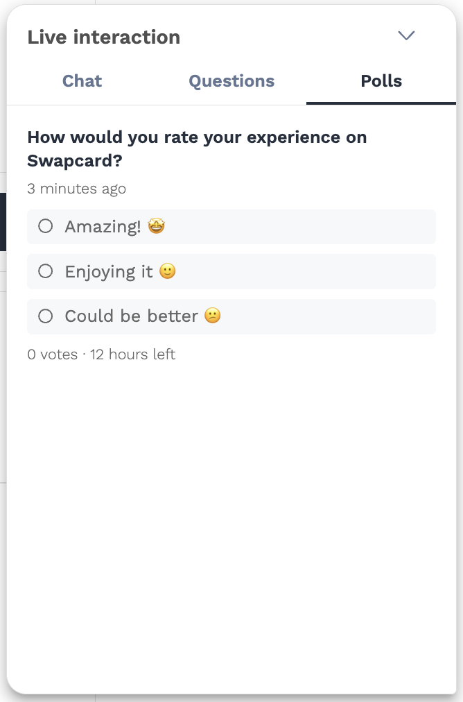
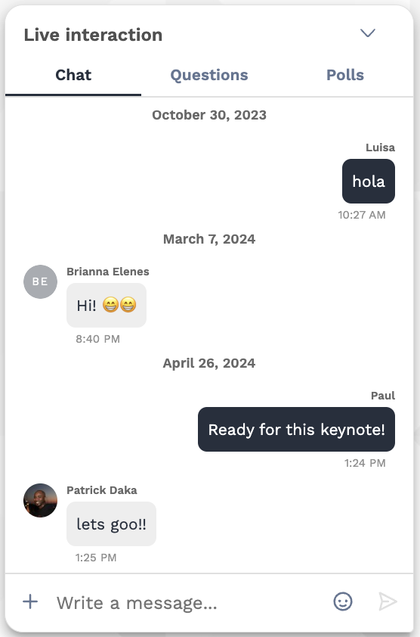
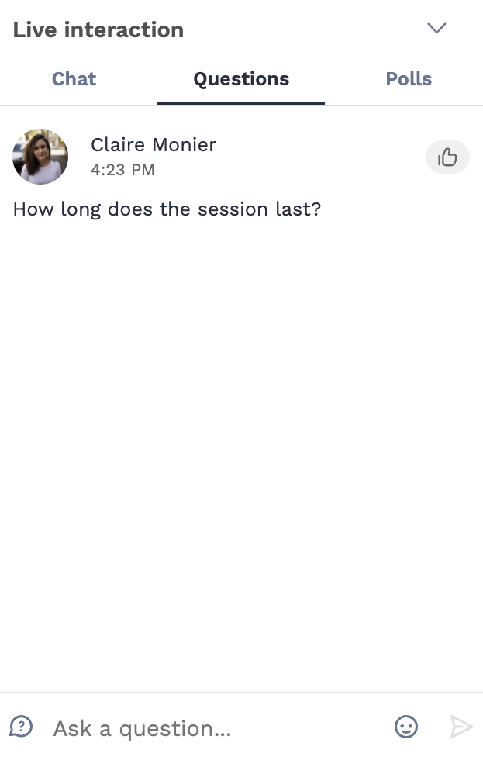
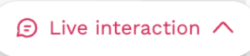
How to interact during a session
With “Live interaction,” you can chat with other attendees, ask questions to the speakers, and answer polls created by the organizers or speakers.
You can react and answer to other people’s messages, or delete your message by clicking
on the three dots next to it.
Questions will be sorted by upvotes where the most liked questions will rise to the top.
The live discussion should be open when sessions are ongoing. If you do not see it, click on the bubble on the bottom right to open it.

Slide 19
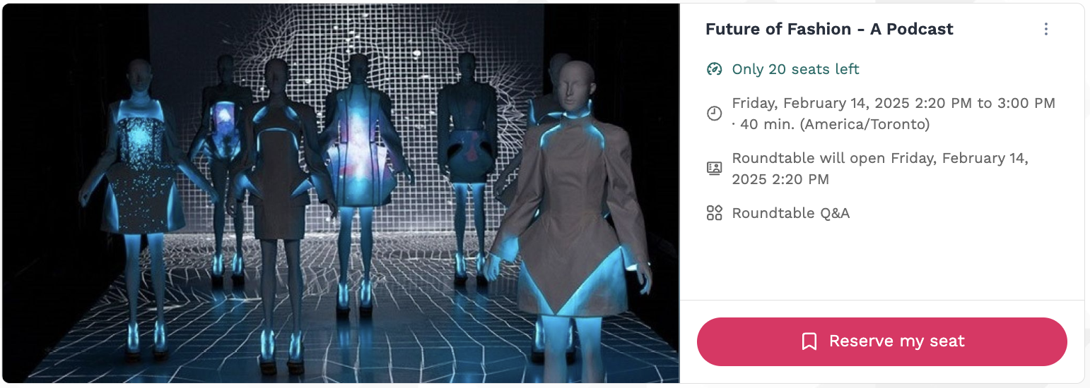
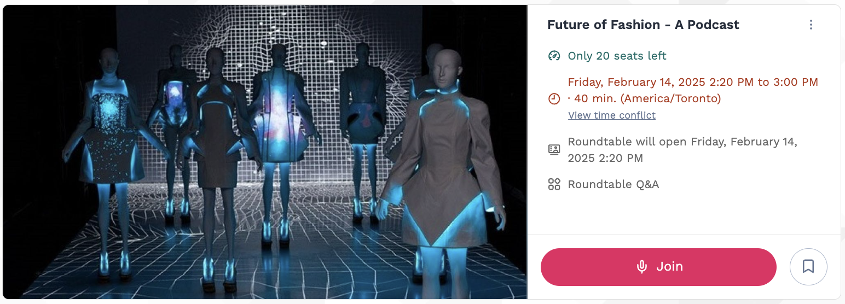
How do roundtable work (1/2)
If the event includes roundtables, the event organizer will make a number of seats available for each roundtable before it begins. To guarantee your seat, you first will have to register for a session. To do so,
you can go to the event's agenda and search for the roundtable session. On the session's page, you will find:
The number of seats available
The button to Register for the session
A countdown indicating the amount of time left before the session starts
Once the session is available, you will be able to join the Roundtable from the session's page simply by clicking on the Join button.
1
2
1
2
3
Note: The Roundtable sessions can’t be accessed through the mobile app, only the web app (from a browser)

Slide 20
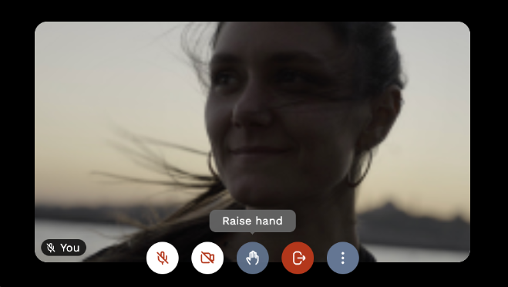
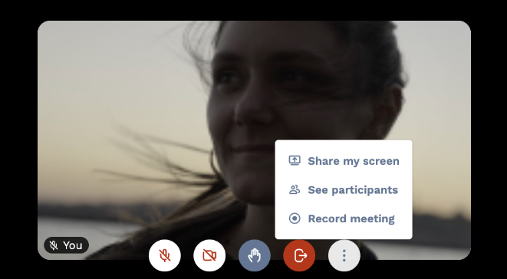
How do roundtable work (2/2)
Once you join the room, you will be prompted to allow Swapcard to access your camera and microphone. By default, you will join with your camera and microphone OFF.
During a roundtable, click this icon to raise your hand. If the session is moderated, the moderator will be allowing people on stage.
You will then see the below options:
1
1
2
2

Slide 21
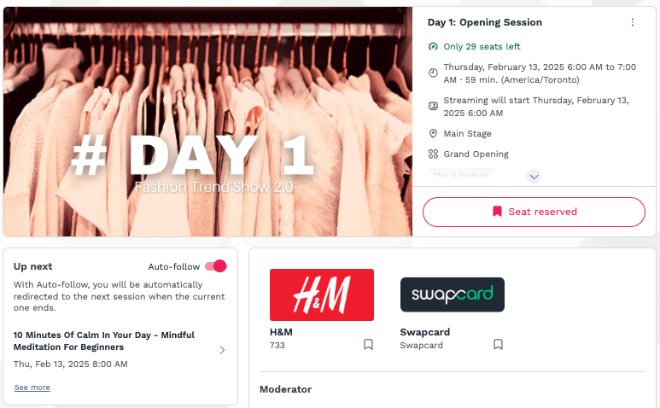
What is auto-follow?
The auto-follow feature is activated by default when you click on a “Live”
schedule button.
This feature allows a seamless experience when watching sessions since it will take you from one session to the next every time a session is completed.
To deactivate it, simply toggle it off.
Note: The auto-follow is never active if you arrive on the session page without clicking a live button or tab.

Slide 22
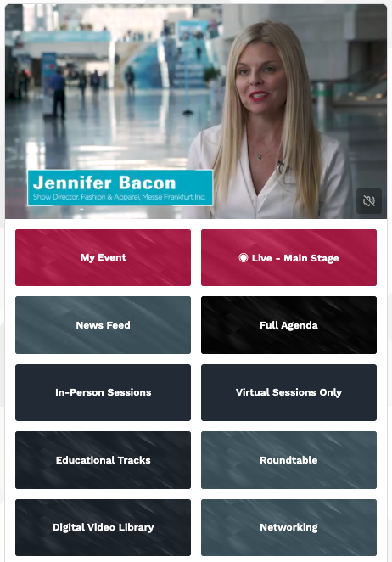
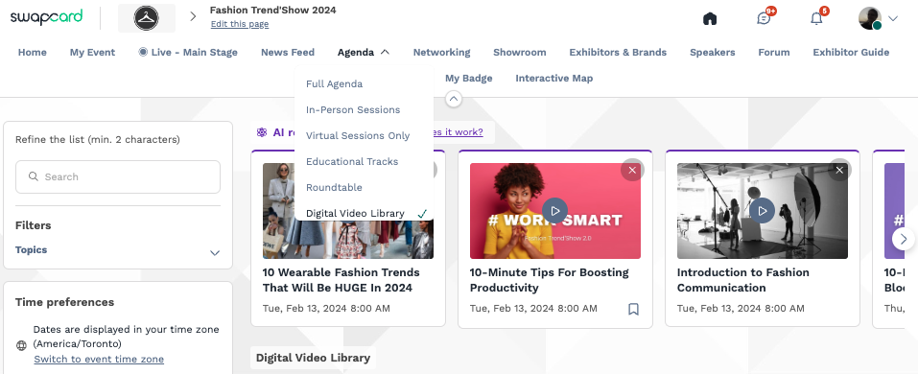
How to watch session on-demand?
The event organizer can make sessions available to watch on-demand.
You can access on-demand sessions through the schedule by clicking on past sessions.
There may be an On-demand, Replay or Digital Video Library button added by the organizer on the homepage. This is where content is available to watch after the event has ended.

Slide 23
Available Features
Networking

Slide 24
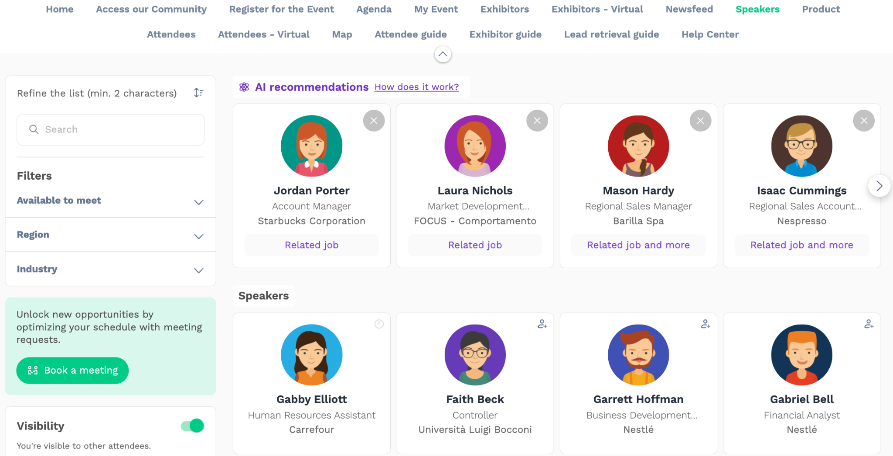
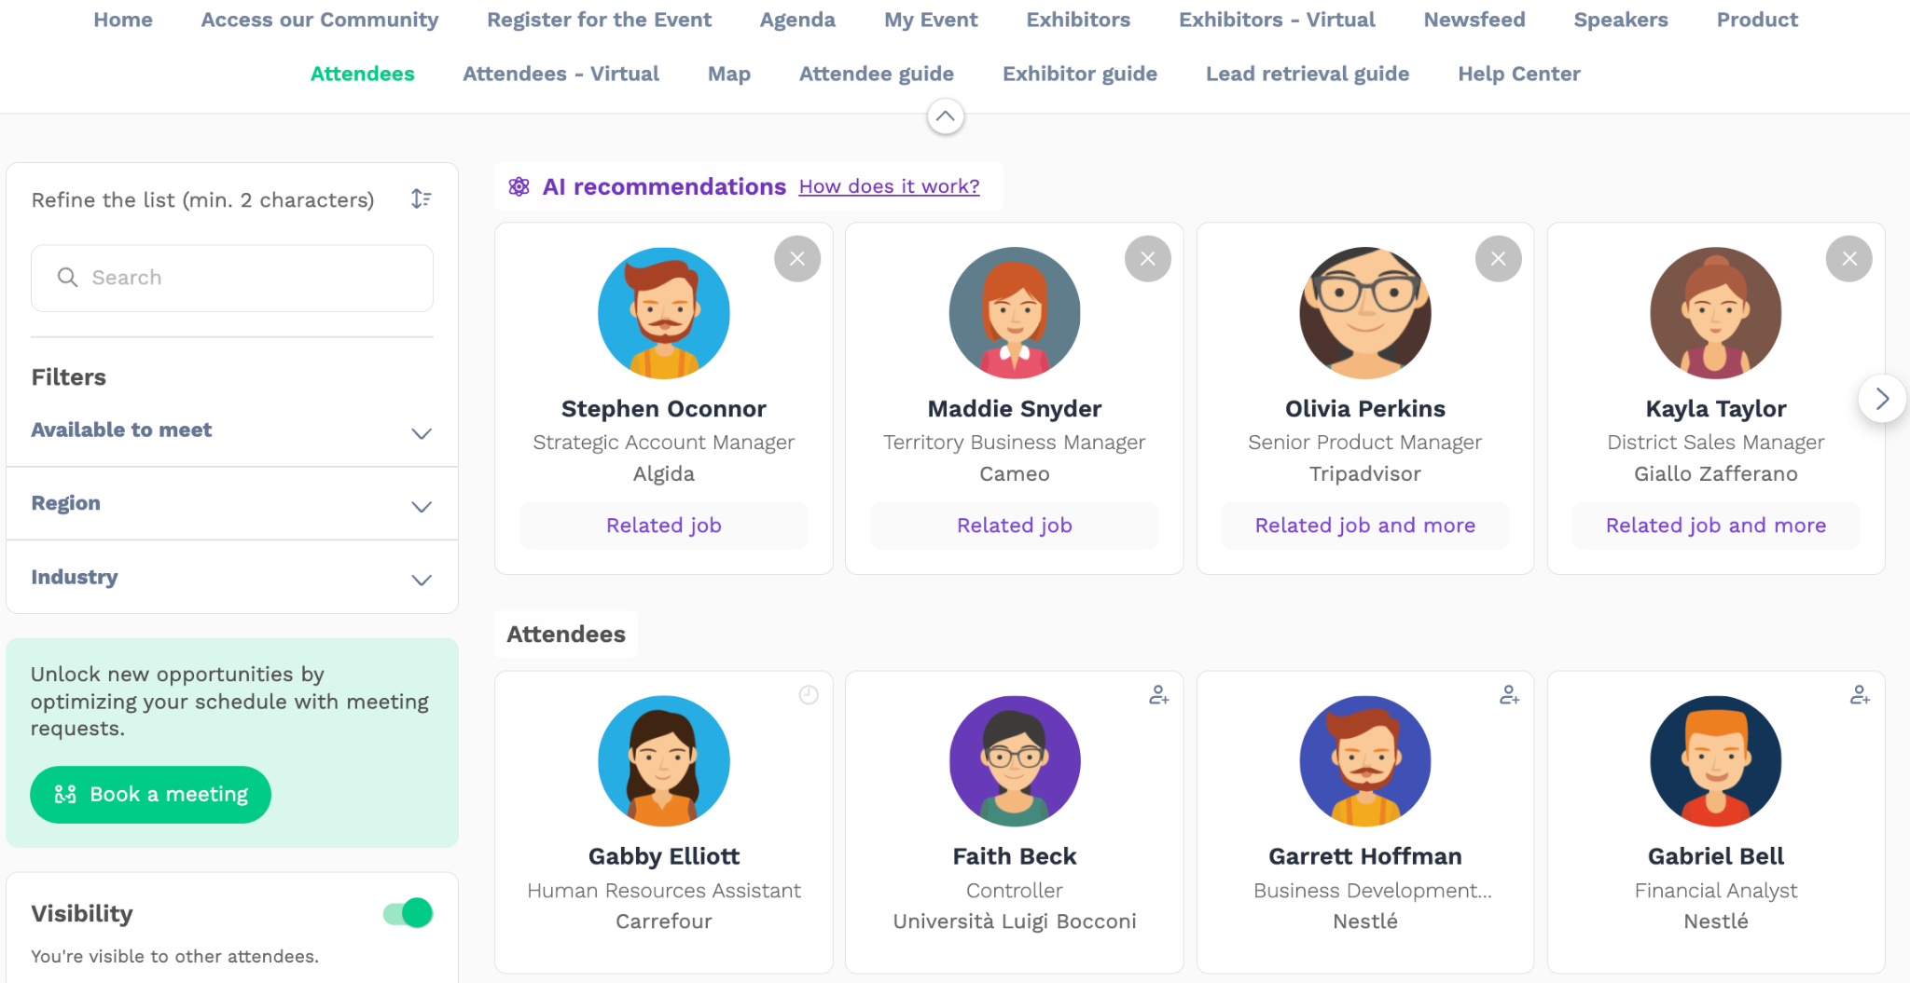
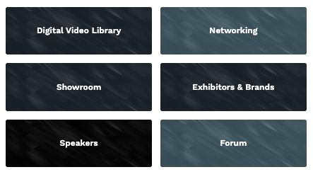
Networking
From the home page or the top navigation bar
you can access the Speaker and Attendee lists (these sections can have different names depending on the event).
Here you can search and find people to connect with. You can chat, have video calls, and book meetings. You can meet virtually or face-to-face depending on how the event is organized.

Slide 25
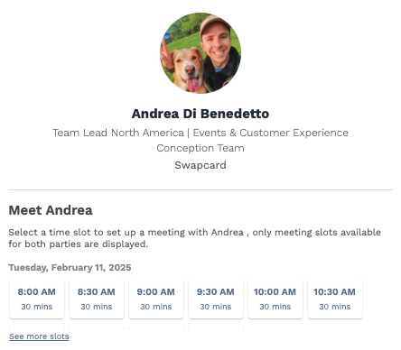
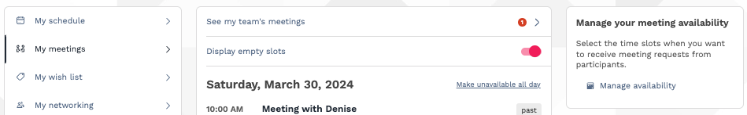
Networking
If you see time slots appearing on people's profiles, it means that the organizer has made it possible for you to book meetings with them. Slots disappear once booked.
You can manage your availability for meetings by going to the My meetings tab in My Event. Making yourself unavailable all day or at specific times will remove meeting slots.

Slide 26
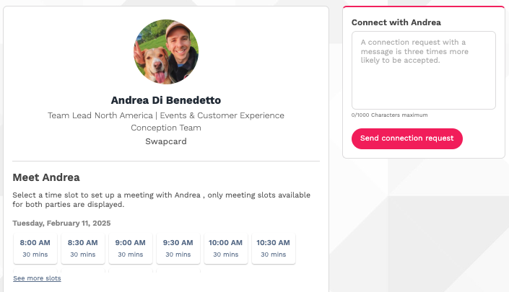
How to send a connection request
To send a connection request, go to their profile (via the list of participants, speakers or a company profile) and click the Send connection request button.
Tip: Add a note to your connection request to introduce yourself and explain the reason for your request.
You will be able to find a full list of your connections in “My Event” under “My Networking”.
Note: Accepting a meeting will automatically make the person who requested the meeting one of your connections with access to your complete profile.

Slide 27
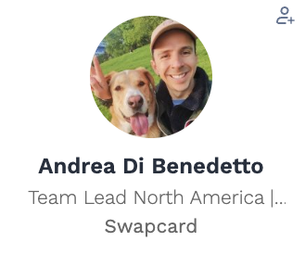
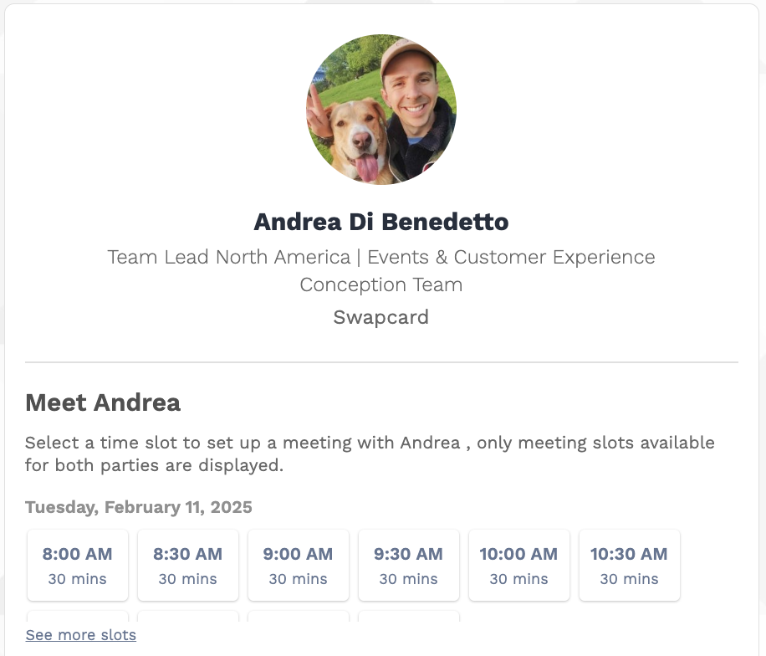

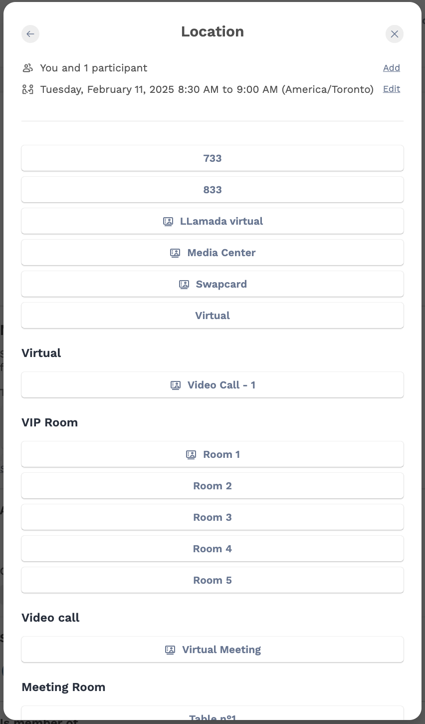
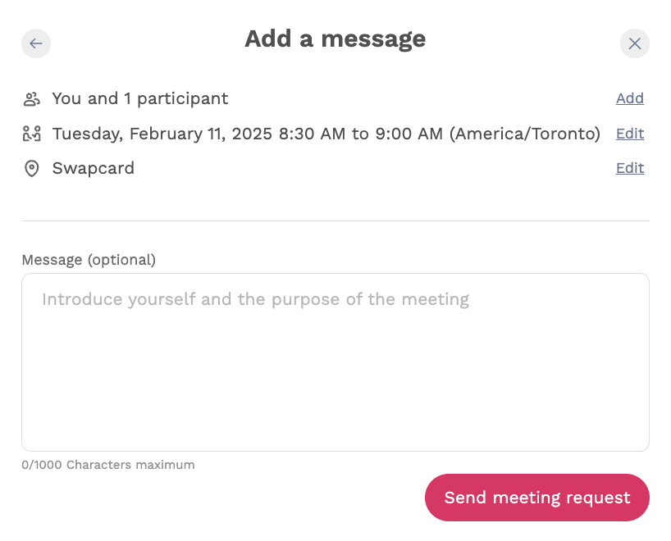
How to request a meeting
Access a person's profile (i.e.: from the Attendees button)
Click on one of the suggested meeting slots. For more slots click “see more slots”
After selecting a slot and choosing a location for the meeting, write a note to the person you would like to meet.
Once done, click “Send meeting request”. At both stages 3 and 4, you can add more people to the meeting and change the meeting’s date/time.
1
1
2
2
3
3
4
4
3

Slide 28
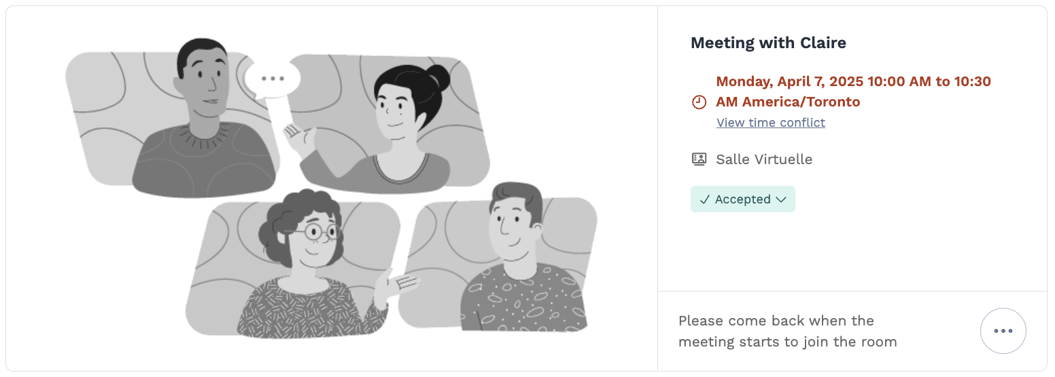
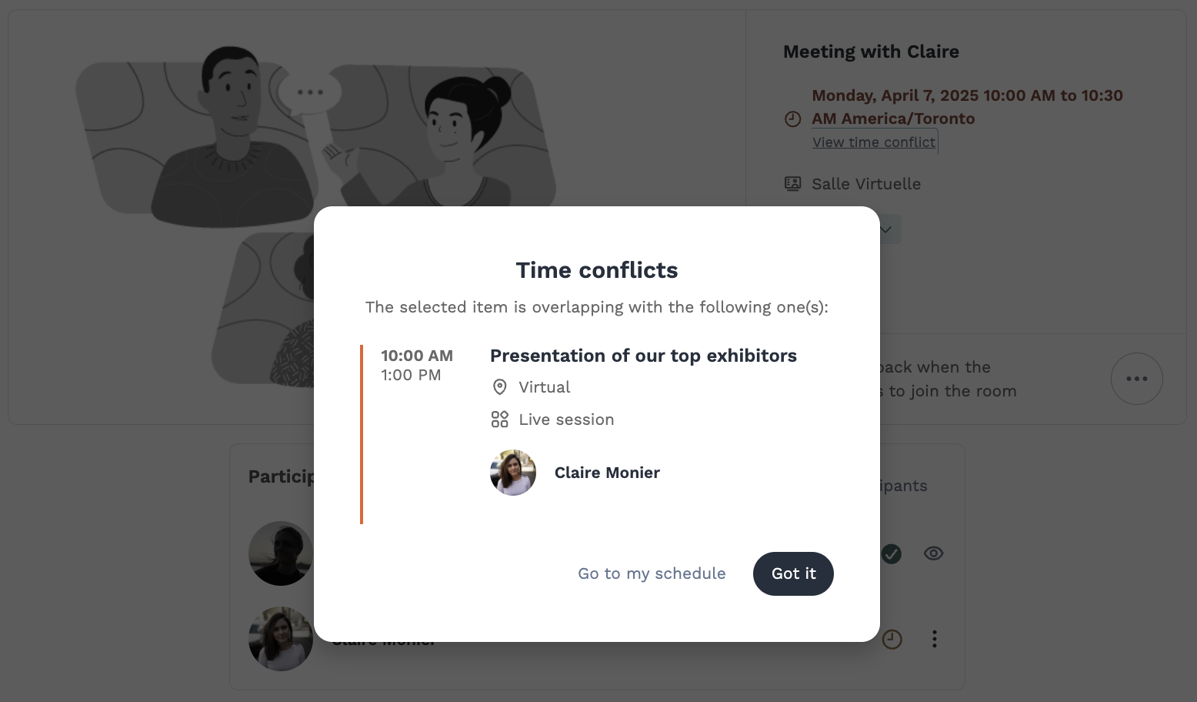

How to have a virtual meeting?
5 minutes before a virtual meeting and 15 minutes before a face-to-face meeting you will receive a reminder email
from which you can click to access the meeting.
If you are already on the platform you can start the meeting by going to the profile of the person you have a meeting with, and click the “Meeting call” button.
This will launch the video call. This button is only available
if the meeting is confirmed.
If you are already committed for another event (session or meeting), you will be notified by a red text on the meeting's page and in the 'My Event' tab to indicate the time conflict.
Note: You can also access a meeting directly from the meeting notification.

Slide 29
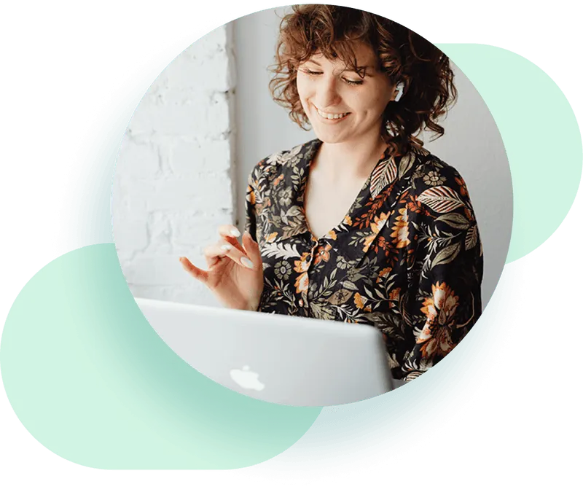


Thank you for taking the time to read this presentation.
Feel free to contact our Support Team if you need assistance.

